Slide 1
Introduction to Set Theory

Slide 2



Sets
Definition. A Set is any well defined collection of “objects.”
Definition. The elements of a set are the objects in a set.
Notation. Usually we denote sets with upper-case letters, elements with lower-case letters. The following notation is used to show set membership
means that x is a member of the set A
means that x is not a member of the set A.

Slide 3
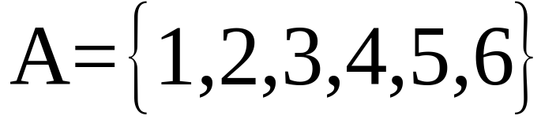
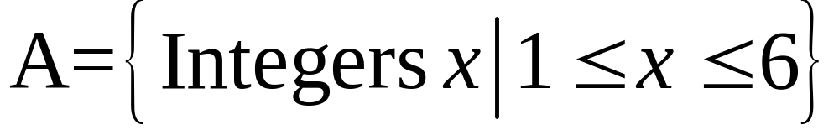

Ways of Describing Sets
List the elements
Give a verbal description
  “A is the set of all integers from 1 to 6, inclusive”
Give a mathematical inclusion rule

Slide 4


Some Special Sets
The Null Set or Empty Set. This is a set with no elements, often symbolized by
The Universal Set. This is the set of all elements currently under consideration, and is often symbolized by

Slide 5


Membership Relationships
Definition. Subset.
“A is a subset of B”
We say “A is a subset of B” if , i.e., all the members of A are also members of B. The notation for subset is very similar to the notation for “less than or equal to,” and means, in terms of the sets, “included in or equal to.”

Slide 6



Membership Relationships
Definition. Proper Subset.
“A is a proper subset of B”
We say “A is a proper subset of B” if all the members of A are also members of B, but in addition there exists at least one element c such that but . The notation for subset is very similar to the notation for “less than,” and means, in terms of the sets, “included in but not equal to.”

Slide 7

Combining Sets – Set Union
“A union B” is the set of all elements that are in A, or B, or both.
This is similar to the logical “or” operator.

Slide 8

Combining Sets – Set Intersection
“A intersect B” is the set of all elements that are in both A and B.
This is similar to the logical “and”

Slide 9

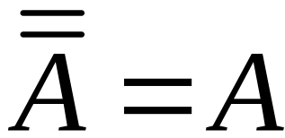
Set Complement
“A complement,” or “not A” is the set of all elements not in A.
The complement operator is similar to the logical not, and is reflexive, that is,

Slide 10


Set Difference
The set difference “A minus B” is the set of elements that are in A, with those that are in B subtracted out. Another way of putting it is, it is the set of elements that are in A, and not in B, so

Slide 11






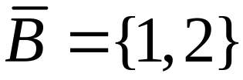
Examples

Slide 12
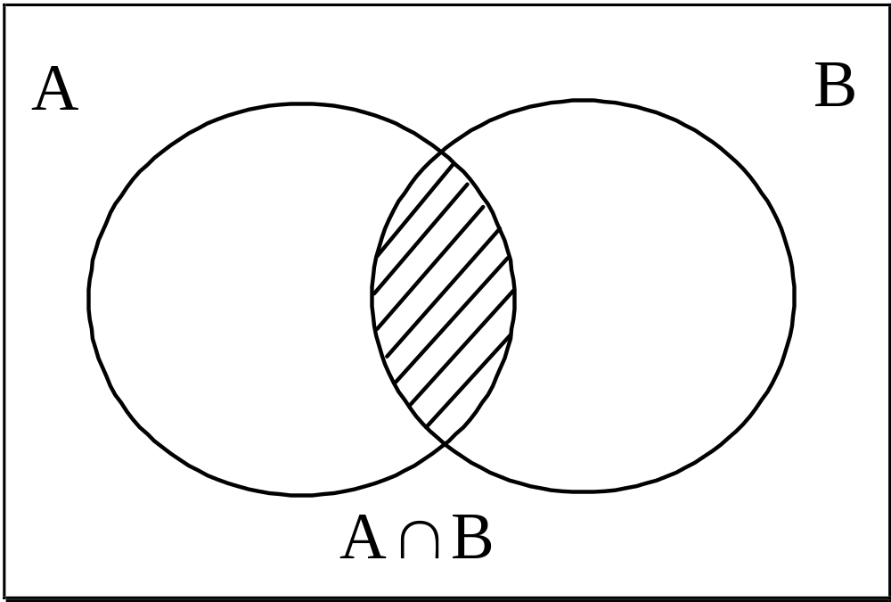
Venn Diagrams
Venn Diagrams use topological areas to stand for sets. I’ve done this one for you.

Slide 13
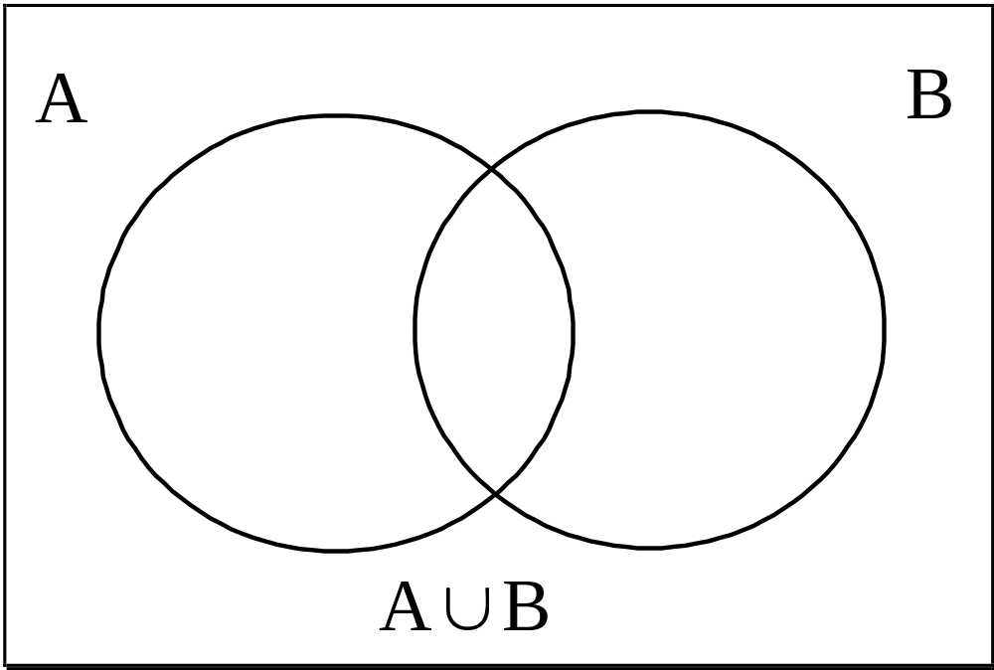
Venn Diagrams
Try this one!

Slide 14
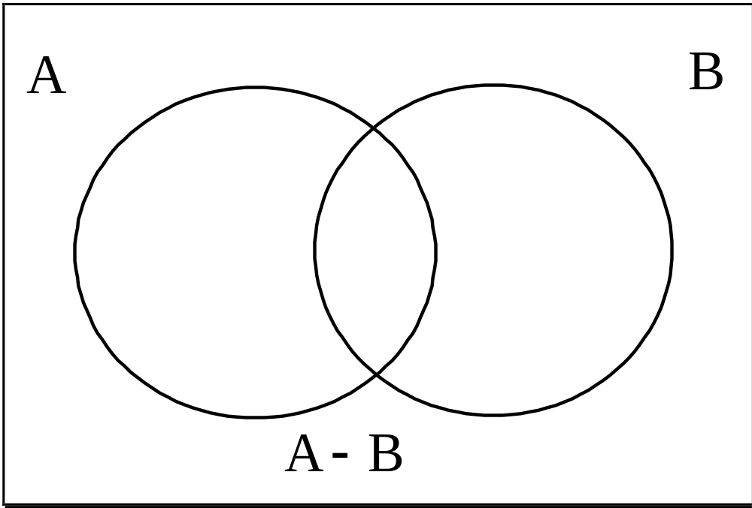
Venn Diagrams
Here is another one

Slide 15


Mutually Exclusive and Exhaustive Sets
Definition. We say that a group of sets is exhaustive of another set if their union is equal to that set. For example, if
we say that A and B are exhaustive with respect to C.
Definition. We say that two sets A and B are mutually exclusive if , that is, the sets have no elements in common.

Slide 16
Set Partition
Definition. We say that a group of sets partitions another set if they are mutually exclusive and exhaustive with respect to that set. When we “partition a set,” we break it down into mutually exclusive and exhaustive regions, i.e., regions with no overlap. The Venn diagram below should help you get the picture. In this diagram, the set A (the rectangle) is partitioned into sets W,X, and Y.

Slide 17
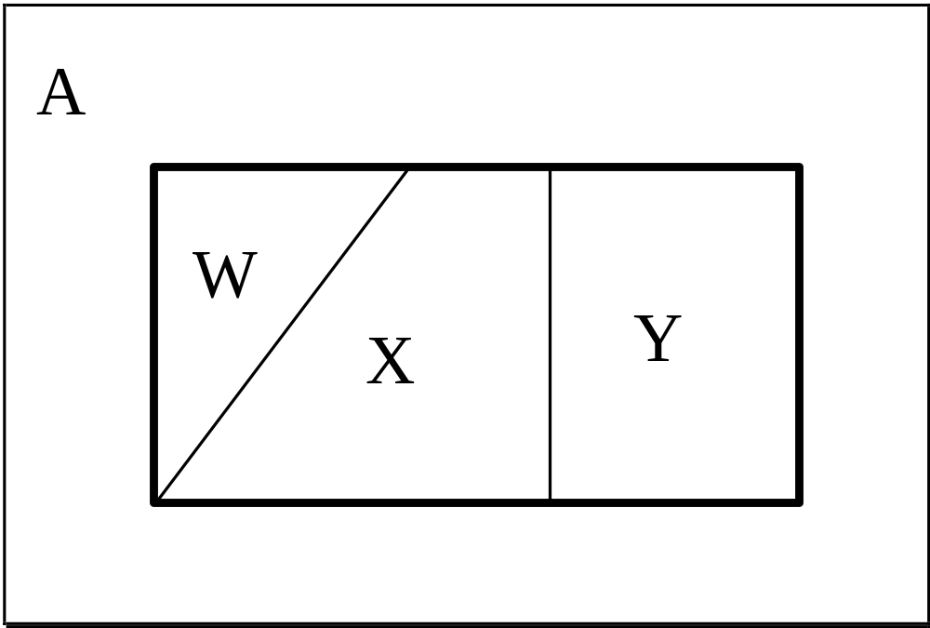
Set Partition

Slide 18

Some Test Questions

Slide 19

Some Test Questions

Slide 20

Some Test Questions

Slide 21

Some Test Questions

Slide 22

Some Test Questions

Slide 23

Some Test Questions

Slide 24

Some Test Questions

Slide 25


Some Test Questions

Slide 26

Some Test Questions

